Slide 1
Introduction to
Model Predictive Control
Thomas A. Badgwell, PhD
Collaborative Systems Integration
tom.badgwell@csi-automation.com
July 9, 2022

Slide 2
Outline
Refinery Process Control
Fired Heater Control Problem
Fired Heater Manual Operation (demo)
Fired Heater PID Control Solution
Fired Heater MPC Control Solution
Fired Heater MPC Control Solution (demo)
The MPC Algorithm
Summary

Slide 3
Outline
Refinery Process Control
Fired Heater Control Problem
Fired Heater Manual Operation (demo)
Fired Heater PID Control Solution
Fired Heater MPC Control Solution
Fired Heater MPC Control Solution (demo)
The MPC Algorithm
Summary

Slide 4
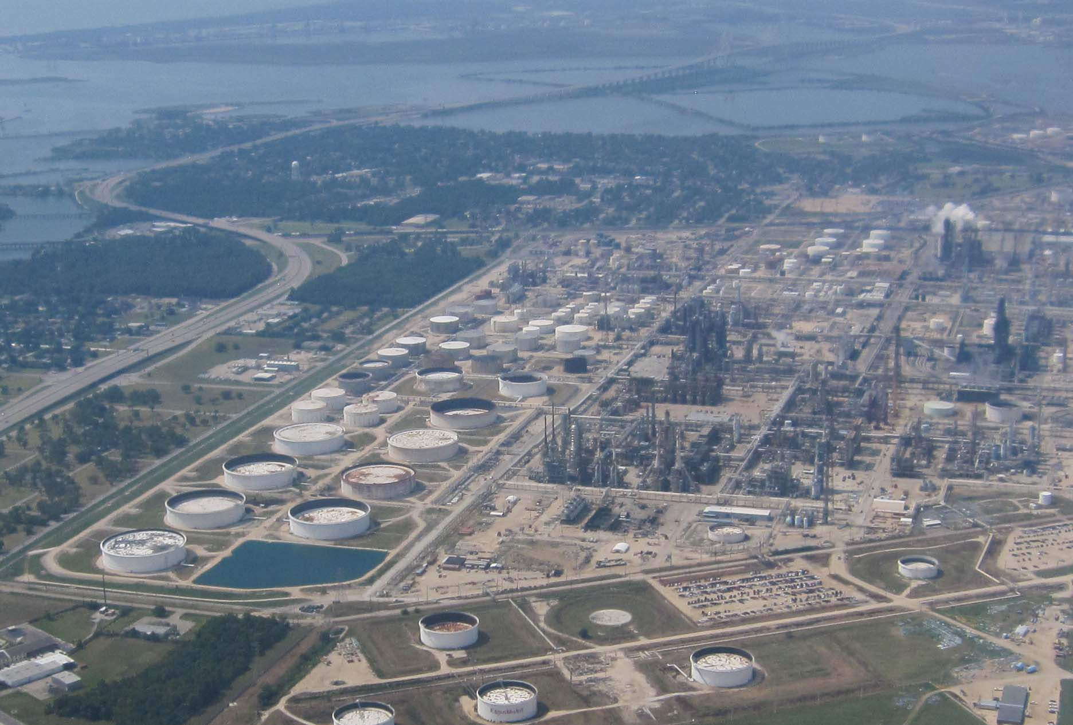
1.1 Petroleum Refinery (ExxonMobil Baytown)
Fired Heater

Slide 5
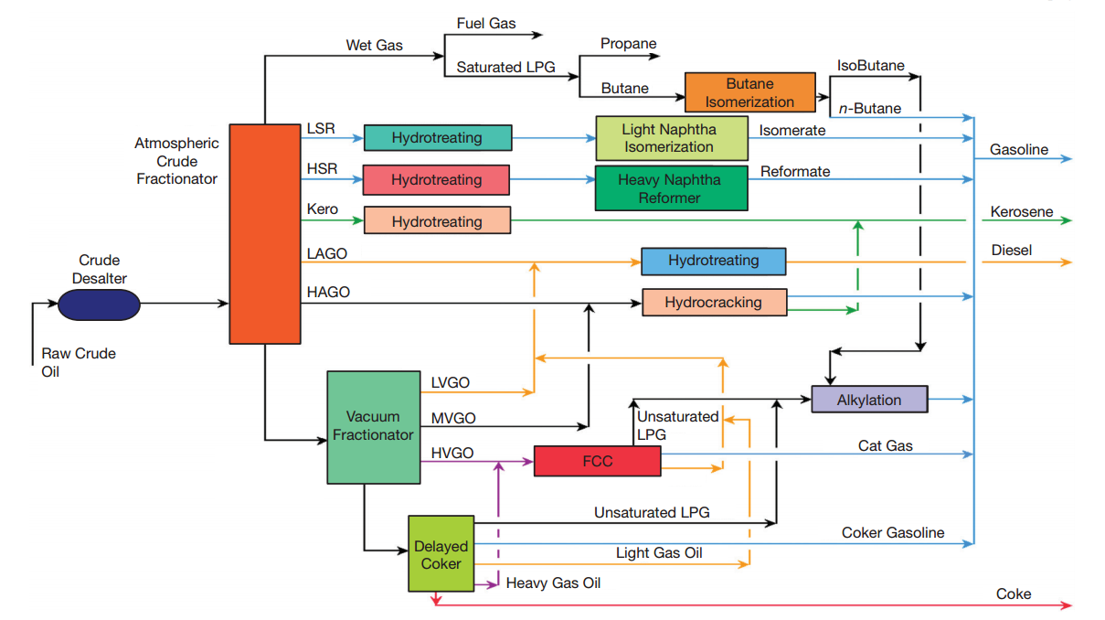
1.2 Refinery Operation [1]
Safety
Environmental Compliance
Reliability
Economic Optimization
Crude
Heater

Slide 6
1.3 Refinery Process Control Hierarchy
Planning
PIMS (weekly)
Refinery-wide/Circuit-wide
Scheduling
Orion
(daily)
Crude
Processing
Products
Real-Time
Optimization
RTO
(hourly)
Crude Units
FCC and Alky Units
Energy
Resid
System
Blending
MPC Controllers
(1 minute)
PID Controllers
(1/3 sec)
Valves & Sensors

Slide 7
1.4 Making money with Process Control
Max Spec or Constraint
New Average
Giveaway
Old Average
Operator
Control
Multi-variable
Control
MPC Control
Current Operation
Tighter Control
Move Average Closer to Constraint

Slide 8
Outline
Refinery Process Control
Fired Heater Control Problem
Fired Heater Manual Operation (demo)
Fired Heater PID Control Solution
Fired Heater MPC Control Solution
Fired Heater MPC Control Solution (demo)
The MPC Algorithm
Summary

Slide 9
2.1 Fired Heater Control Problem
Adjust pass flows
and fuel gas
To control combined
Flowrate
Temperature
(3)
(2)
MVs
(Manipulated
Variables)
F
i
r
e
d
Don’t let tubeskins get
too hot
(1)
H
e
a
t
e
r
CVs
(Controlled
Variables)
pass 1
Oil
c
o
m
b
i
n
e
d
f
l
o
w
pass 2
Adjust for changes to
inlet temperatures
Keep the pass outlet
temperatures the same
(4)
f
u
e
l
g
a
s
FG
DVs
(Disturbance
Variables)

Slide 10
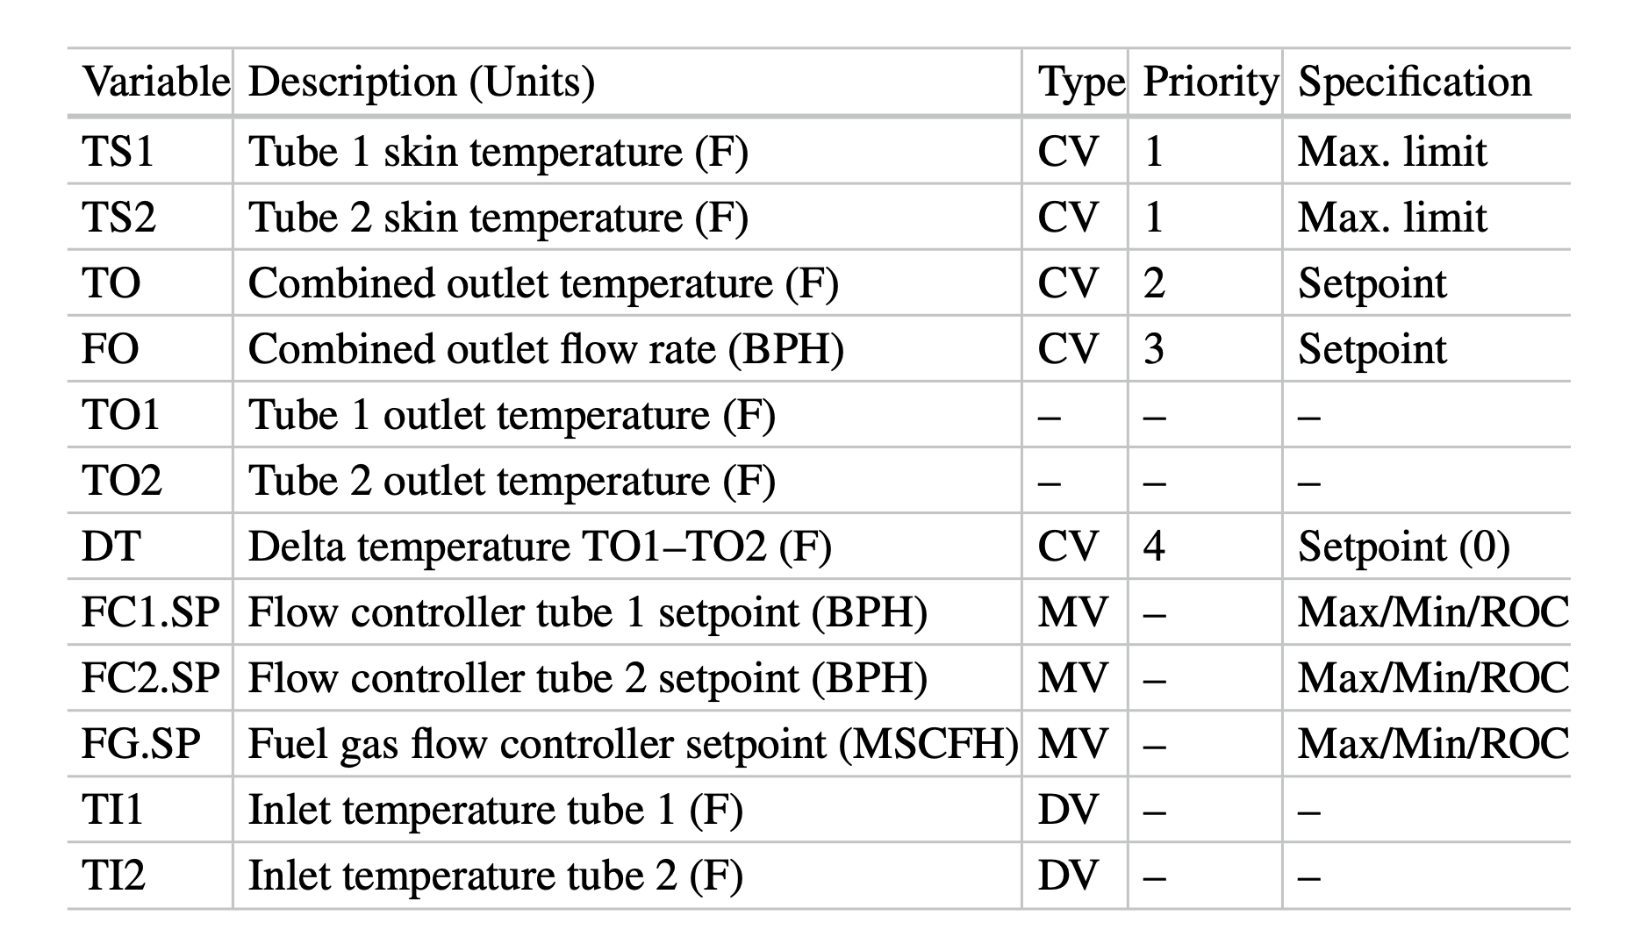
2.2 Fired Heater Control Specification

Slide 11
Outline
Refinery Process Control
Fired Heater Control Problem
Fired Heater Manual Operation (demo)
Fired Heater PID Control Solution
Fired Heater MPC Control Solution
Fired Heater MPC Control Solution (demo)
The MPC Algorithm
Summary

Slide 12
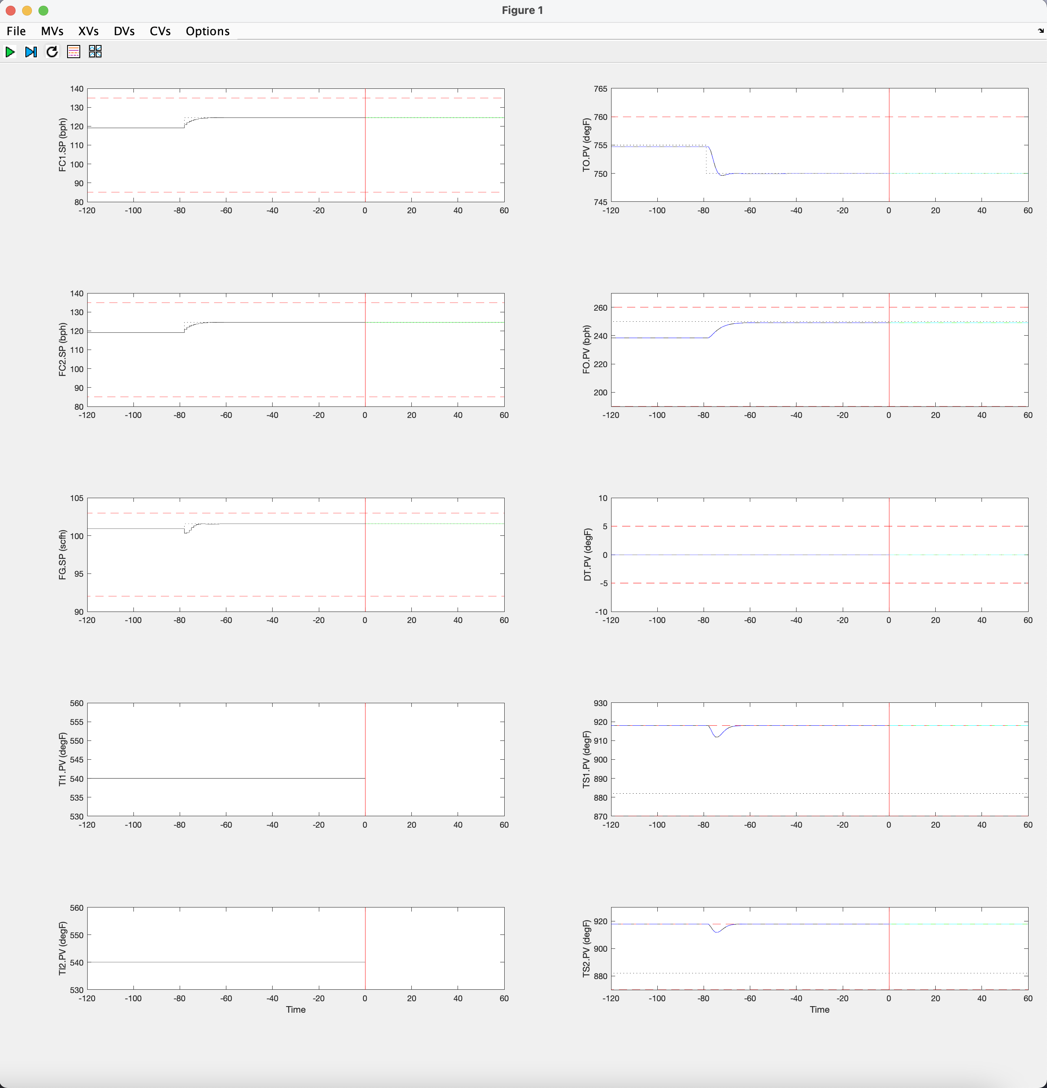
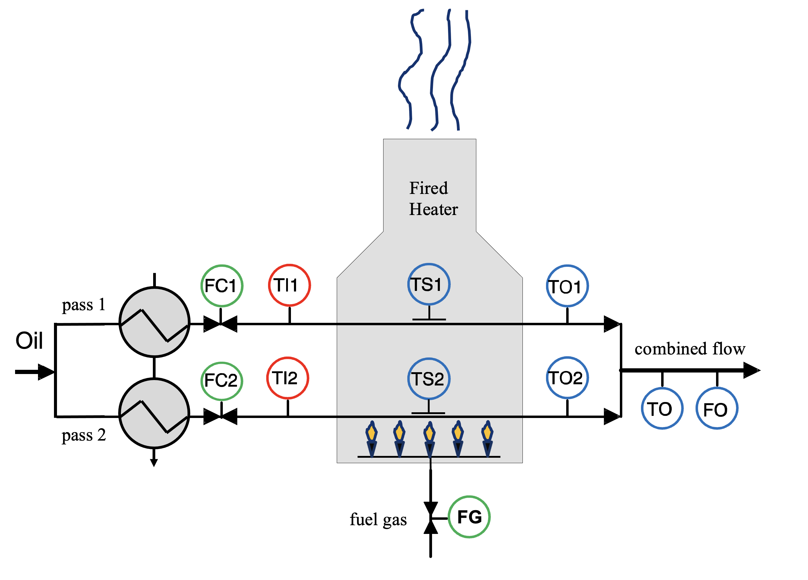
3.1 Fired Heater MPC Open-Loop Demo using MPCSIM
M.J. Risbeck, J.B. Rawlings, “MPCTools: Nonlinear model predictive control tools for CasADi (Octave interface)”, https://bitbucket.org/rawlings-group/octave-mpctools, (2017).
J.A.E. Andersson, J. Gillis, G. Horn, J.B. Rawlings, M. Diehl, “CasADi – A software framework for nonlinear optimization and optimal control”, Mathematical Programming Computation, 11, 1, (2019).

Slide 13
Outline
Refinery Process Control
Fired Heater Control Problem
Fired Heater Manual Operation (demo)
Fired Heater PID Control Solution
Fired Heater MPC Control Solution
Fired Heater MPC Control Solution (demo)
The MPC Algorithm
Summary

Slide 14
4.1 Fired Heater PID Control Solution: Base-Level PID Flow Controllers
F
i
r
e
d
Pass 1 Flow Controller
H
e
a
t
e
r
FC1.SP
FC1.PV
PID
1/3 S
FC1.CO
pass 1
c
o
m
b
i
n
e
d
f
l
o
w
Oil
pass 2
FC2.CO
Pass 2 Flow Controller
FG
FG.PV
FC2.SP
FC2.PV
f
u
e
l
g
a
s
Fuel Gas Flow Controller
FG.SP
PID
1/3 S
FG.CO
PID
1/3 S

Slide 15
4.2 Fired Heater PID Control Solution: Total Flow and Pass Temp Balancing controllers
FO.PV
FO.SP
Total Flow Controller
Pass Temp Balance Controller
DT.PV
PID
30 S
PBAL
120 S
Total Flow Split
+
Split
30 S
FC1 Sum
+
-
+
-
Sum
30 S
+
+
FC1.SP
FC2 Sum
Sum
30 S
FC2.SP
FG

Slide 16
4.3 Fired Heater PID Control Solution: Outlet Temp and Tubeskin Temp Constraint controllers
TS1.MAX
Tubeskin 1 Max Temp Controller
Tubeskin Max Temp
Constraint Controller
TS1.PV
PID
5 S
TS2.MAX
Tubeskin 2 Max Temp Controller
TS2.PV
PID
5 S
TO.SP
Outlet Temp Controller
TO.PV
PID
LSEL
5 S
5 S
FG

Slide 17
4.3 Limitations of the Fired Heater PID Control Solution
The Total Flow controller and the Outlet Temperature controller will interact – changing the setpoint of one controller causes a disturbance to the other control loop
There is no clear way to enforce the control priorities – i.e. if the tubeskin temperature for pass one violates its limit, the control will decrease the fuel gas flow, giving up on the outlet temperature setpoint instead of the total flow setpoint
It is difficult to decide how to deal with pass inlet temperature variations in a feedforward manner.

Slide 18
Outline
Refinery Process Control
Fired Heater Control Problem
Fired Heater Manual Operation (demo)
Fired Heater PID Control Solution
Fired Heater MPC Control Solution
Fired Heater MPC Control Solution (demo)
The MPC Algorithm
Summary

Slide 19
5.1 Fired Heater Model Inputs/Outputs
Process
Inputs
Process
outputs
MVs
(Manipulated
Variables)
FC1.SP
TO
FC2.SP
FO
CVs
(Controlled
Variables)
FG.SP
DT = TO1 – TO2
DVs
(Disturbance
Variables)
TI1
TS1
TI2
TS2
Multiple Input / Multiple Output (MIMO)

Slide 20
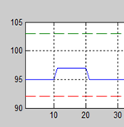
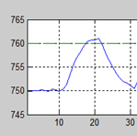
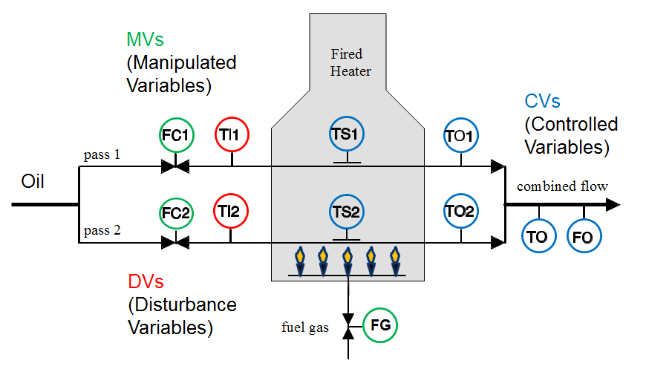
5.2 Fired Heater Step Test
FG

Slide 21
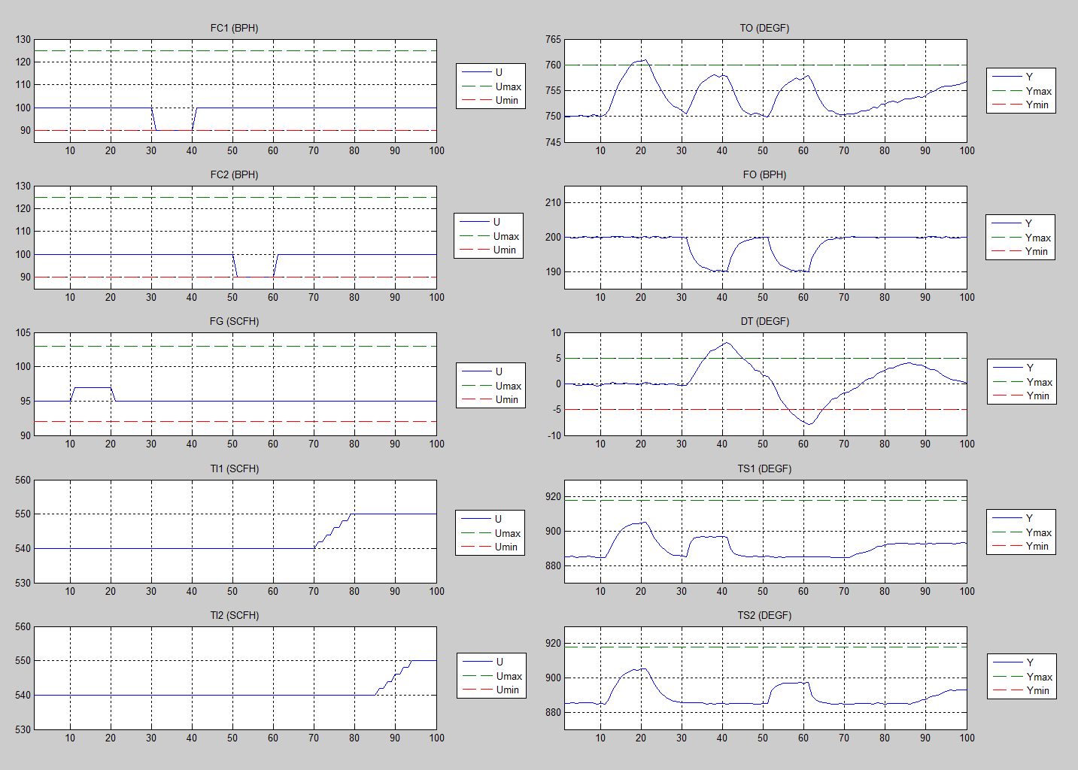
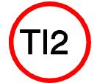
5.3 Fired Heater Step Test

Slide 22
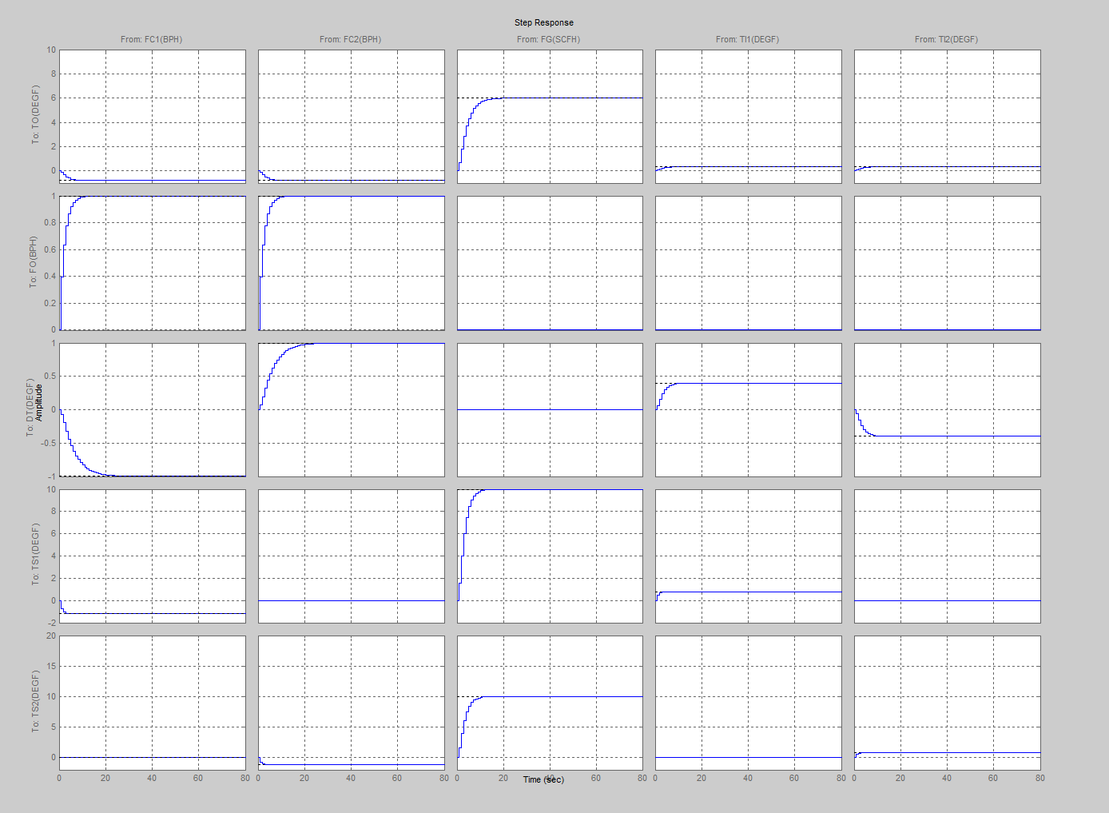
5.4 Fired Heater Model (Step Response)
Gain

Slide 23
5.5 Fired Heater MPC Configuration
MPC
(every minute)
DT
-
-
+
MVs
(Manipulated
Variables)
CVs
(Controlled
Variables)
DVs
(Disturbance
Variables)
FG

Slide 24
Outline
Refinery Process Control
Fired Heater Control Problem
Fired Heater Manual Operation (demo)
Fired Heater PID Control Solution
Fired Heater MPC Control Solution
Fired Heater MPC Control Solution (demo)
The MPC Algorithm
Summary

Slide 25
6.1 Fired Heater MPC Closed-Loop Demo using MPCSIM
M.J. Risbeck, J.B. Rawlings, “MPCTools: Nonlinear model predictive control tools for CasADi (Octave interface)”, https://bitbucket.org/rawlings-group/octave-mpctools, (2017).
J.A.E. Andersson, J. Gillis, G. Horn, J.B. Rawlings, M. Diehl, “CasADi – A software framework for nonlinear optimization and optimal control”, Mathematical Programming Computation, 11, 1, (2019).

Slide 26
Outline
Refinery Process Control
Fired Heater Control Problem
Fired Heater Manual Operation (demo)
Fired Heater PID Control Solution
Fired Heater MPC Control Solution
Fired Heater MPC Control Solution (demo)
The MPC Algorithm
Summary

Slide 27
7.1 Model Predictive Control (MPC) Algorithm
State Estimation: Estimate the process state (Where is the process going?)
Steady-state optimization: Calculate the steady-state target (Where should the process go?)
Dynamic optimization: Calculate the move plan (How do you get it there?)
Inject first adjustment (move) into the process
Wait for next control cycle
Go back to step 1.

Slide 28
7.2 MPC Block Diagram
Where should the
process go?
How do you
get it there?
CV, MV
Targets
$$x_{s}$$
$$u_{s}$$
Steady-State
Optimization
Dynamic
Optimization
MVs
CVs
Process
$$y_{t}$$
$$u_{t}$$
Where is the
process going?
Model
$$\tilde{x}$$
State
Estimator
MPC
Model Predictive Control: A class of optimization-based control algorithms that use an explicit process Model to Predict future errors while computing optimal Control moves over a specified future time horizon.

Slide 29
7.3 Discrete-time State-Space Model
By combining theory and data, MPC models can be written in discrete state-space form:

Slide 30
7.4 State Estimation (Where is the process going?)
Moving Horizon Estimation (MHE) optimizes over a horizon of past behavior:
y
u
$$k−N_{e}$$
$$k$$
$$k+N_{c}$$

Slide 31
7.5 Steady-State Optimization (Where should the process go?)
The Steady-State Optimizer provides steady-state targets ($x_{s},u_{s}$):
y
y_{s}
u_{s}
u
$$k−N_{e}$$
$$k$$
$$k+N_{c}$$

Slide 32
7.6 Dynamic Optimization (How do you get it there?)
The Dynamic Optimizer provides a move plan ($u_{k}⋯u_{k+N_{c}−1}$) :
y
y_{s}
u_{s}
u
$$k−N_{e}$$
$$k$$
$$k+N_{c}$$

Slide 33
7.7 Impact of MPC on Process Control
MPC has become the standard technology for tackling constrained multivariable process control problems
There are now well-established methods for training implementers, estimating benefits, executing projects, and sustaining benefits
Size and scope of MPC applications have increased with time; representative medium size is now around 30x50
MPC has been applied to a wide range of control problems, from refining and petrochemical processes to polymers, specialty chemicals, aerospace, pulp and paper, air separation, food processing, etc.
Equally important is the intellectual impact; academics and practitioners today equate advanced control with MPC, and MPC provides the default intellectual framework for modern control theory

Slide 34
Outline
Refinery Process Control
Fired Heater Control Problem
Fired Heater Manual Operation (demo)
Fired Heater PID Control Solution
Fired Heater MPC Control Solution
Fired Heater MPC Control Solution (demo)
The MPC Algorithm
Summary

Slide 35
8.1 Summary
Refinery process control systems are implemented in a hierarchy that reflects the operating philosophy:
Safety
Environmental Compliance
Reliability
Economic Optimization
MPC technology sits at a key position in the hierarchy, adding value by minimizing CV variations and moving CVs closer to constraints
The MPC algorithm has three steps: state estimation, steady-state optimization, and dynamic optimization
MPC technology has been applied to many different control problems, with applications reported in refining and petrochemical processes, polymers, specialty chemicals, aerospace, pulp and paper, air separation, food processing, etc.
Equally important is the intellectual impact; academics and practitioners today equate advanced process control with MPC, and MPC provides the default intellectual framework for modern control theory
Notes:
35

Slide 36
8.2 References
T. Olson, “An Oil Refinery Walk-Through,” Chemical Engineering Progress, May, (2014).
S. Joe Qin and T.A. Badgwell, “A survey of industrial model predictive control technology,” Control Engineering Practice, 733-764, (2003).
M.L Darby and M. Nikolaou, “MPC: Current practice and challenges,” Control Engineering Practice, 328–342, (2012).
D.Q. Mayne, J.B. Rawlings, C.V. Rao, and P.O.M. Scokaert, “Constrained model predictive control: Stability and optimality,” Automatica, 789-814, (2000).
J. B. Rawlings and D.Q. Mayne, M.M. Diehl, “Model Predictive Control: Theory, Computation, and Design,” Nob Hill Publishing, (2017).
P.D. Schnelle, J. Laman, and T. A. Badgwell, “Application of State Space MPC to a Commercial Scale Dilution/Pasteurization/Drying Process,“ ISA Expo 2007, Houston, TX, October 2, (2007).
E.L. Haseltine and J.B. Rawlings, “Critical evaluation of extended Kalman filtering and moving horizon estimation,” Ind. Eng. Chem. Res., 2451-2460, (2005).
B.J. Odelson, A. Lutz, and J.B. Rawlings, “The autocovariance least-squares methods for estimating covariances: Application to model-based control of chemical reactors,” IEEE Ctl. Sys. Tech., 532-541, (2006).
G. Pannocchia, J.B. Rawlings, and S.J. Wright, “Fast, large-scale model predictive control by partial enumeration,” Automatica, 852-860, (2007).
Gary, Handwerk, and Kaiser, “Petroleum Refining, Technology and Economics,” Fifth Edition, CRC Press, (2007).
M.A. Henson and D.E. Seborg, “Nonlinear Process Control,” Prentice Hall, (1997).
B. Nicholson, W. Wan, S. Kameswaran, T.A. Badgwell, L.T. Biegler, “A Parallel Interior Point Solver with Cyclic Reduction for Solving Large-Scale Dynamic Optimization Problems, AIChE Annual Meeting, November (2016).
J. Shin, T.A. Badgwell, K.H. Liu and J.H. Lee, “Reinforcement Learning – Overview of Recent Progress and Implications for Process Control”, Computers & Chemical Engineering, 127, 282-294, (2019).
M.J. Risbeck, J.B. Rawlings, “MPCTools: Nonlinear model predictive control tools for CasADi (Octave interface)”, https://bitbucket.org/rawlings-group/octave-mpctools, (2017).
J.A.E. Andersson, J. Gillis, G. Horn, J.B. Rawlings, M. Diehl, “CasADi – A software framework for nonlinear optimization and optimal control”, Mathematical Programming Computation, 11, 1, (2019).

Slide 37
Backup Slides

Slide 38
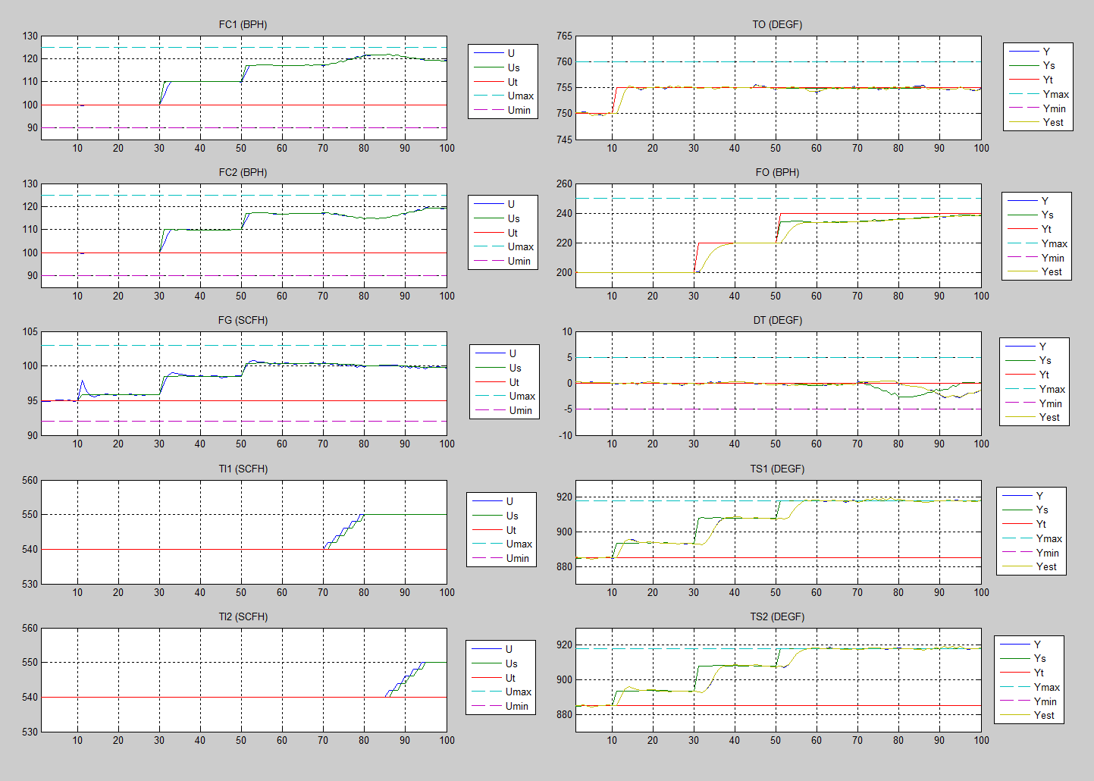
2.7 Fired Heater MPC Closed-Loop Performance

